Slide 1
Interesting case
7th June 2019
R2สุพฤกษ์ /อ.กฤษณะ

Slide 2
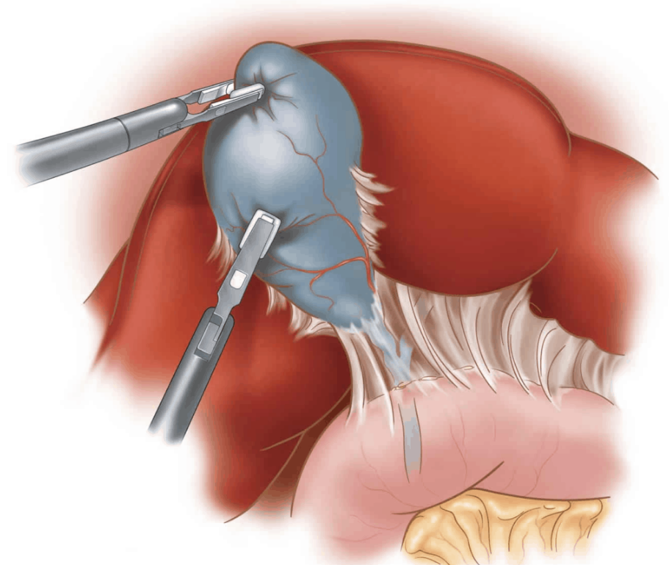
Case
ผู้ป่วยชาย อายุ 58ปี u/d Kennedy’s disease, Chronic viral hepatitis B infection
Dx :Gallbladder polyp
Op : Laparoscopic cholecystectomy

Slide 3
History
CC : ตรวจพบ gallbladder polyp 8 เดือนPTA
PI : 8เดือนก่อนตรวจพบLFTผิดปกติ(AST/ALTสูง) ทำU/S abdomen พบgallbladder polyp
  2เดือนก่อนF/U gallbladder polypใหญ่ขึ้นจึงนัดมาผ่าตัด
  ไม่มีอาการปวดท้อง ไม่มีตัวเหลืองตาเหลือง ทานอาหารได้ปกติ ขับถ่ายปกติ ไม่มีไข้

Slide 4
R1
History

Slide 5
History
Dx Kennedy disease ปี 55 ด้วยอาการกล้ามเนื้อมือลีบ มีอาการแขนขาอ่อนแรง
ปัจจุบันยังมีอาการอ่อนแรงบางครั้งเช่น เดินขึ้นบันไดแล้วยกขาลำบาก มีอาการมือสั่นเล็กน้อย ใบหน้ากระตุกบางครั้ง กินอาหารได้ปกติ กลืนได้ปกติ ไม่สำลักอาหาร พูดชัดปกติ ไม่มีเสียงแหบ หายใจได้ปกติ ไอได้ปกติ

Slide 6
History
Chronic viral hepatitis B infection
No current medication
No drug or food allergy
No alcohol drinking
No smoking

Slide 7
History
No previous surgery / anesthesia
Functional class I

Slide 8
R1
Physical examination

Slide 9
Physical examination
Vital signs
  BP 122/82 mmHg HR 70 bpm
  BT 37 c RR 16 bpm
BW 68 kgs Ht 170 cms BMI 23.5 kg/m²
GA : A Thai male, good consciousness, well co-operated
HEENT : no pale conjunctivae, no jaundice

Slide 10
Physical examination
Airway :
  Mallampati grade 1
  Thyromental distance > 6 cm
  Mouth opening > 3 cm
  Upper lip bite test grade I
  No prominent incisor
  no limit head and neck motion

Slide 11
Physical examination
RS : clear, equal breath sound
CVS : pulse full and regular, normal s1,s2 , no murmur
Abdomen : soft, not tender

Slide 12
Physical examination
Extremities : no pitting edema, muscle atrophy both hands
Neuro : E4V5M6, Pupil 2 mm RTLBE , Full EOM, no facial palsy, intact gag reflex, tongue fasciculation
motor grade 5 all, sensory intact ,normal Babinski sign

Slide 13
R1
Investigation

Slide 14
Investigation
CBC : Hb 14g/dl Hct45%,
Platelet239,000/mm3
BUN/Cr :10.1/ 0.56 mg/dL TP 7.61 , Alb 4.8
Na :140mEq/L TB 0.59, DB 0.21
K :3.62mEq/L AST 40, ALT 61 , ALP 53
Cl :101mEq/L
HCO₃ :22.4mEq/L

Slide 15
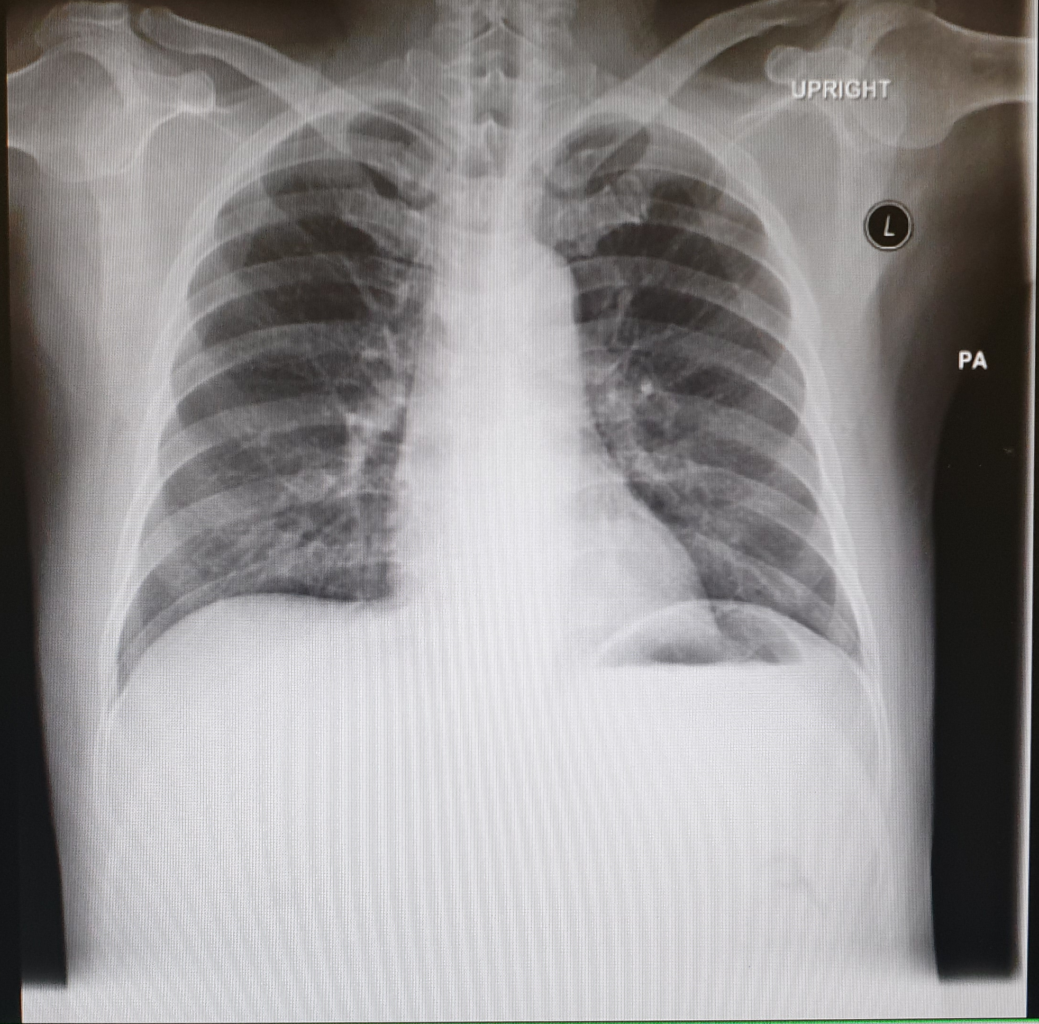
CXR

Slide 16
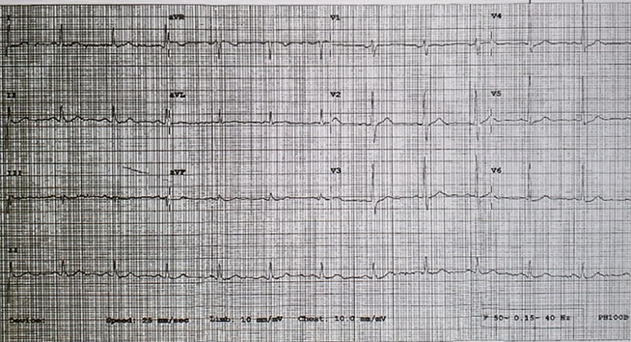
EKG

Slide 17
R1
Problem lists & ASA classification

Slide 18
Problem lists
Gallbladder polyp Operation : LC
Kennedy’s disease
Chronic viral hepatitis B infection

Slide 19
ASA classification
ASA II

Slide 20
R1
Preoperative evaluation

Slide 21
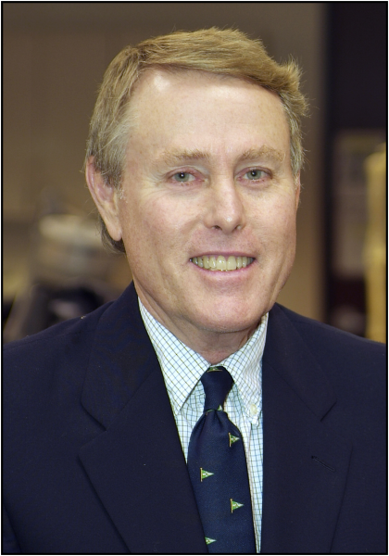
Kennedy’s disease
Kennedy’s disease was named after the neurologist, Dr. William R. Kennedy
First described the disorder in 1968
Notes:
Emergency Sx Timingเหมือนคนปกติ

Slide 22
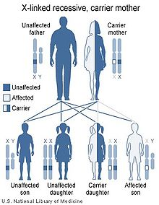
Kennedy’s disease
Rare disease
X-linked slowly progressive neuromuscular disorder
Ages of 20 and 50
1 in 350,000 males and does not typically occur in females

Slide 23
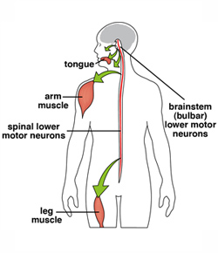
Kennedy’s disease
Spinal Bulbar Muscular Atrophy
Slowly progressive disease with lower motor neuron loss
Progressive weakness in the upper and lower extremities, bulbar weakness, laryngospasm, gynecomastia, and tremor
Notes:
androgen insensitivity

Slide 24
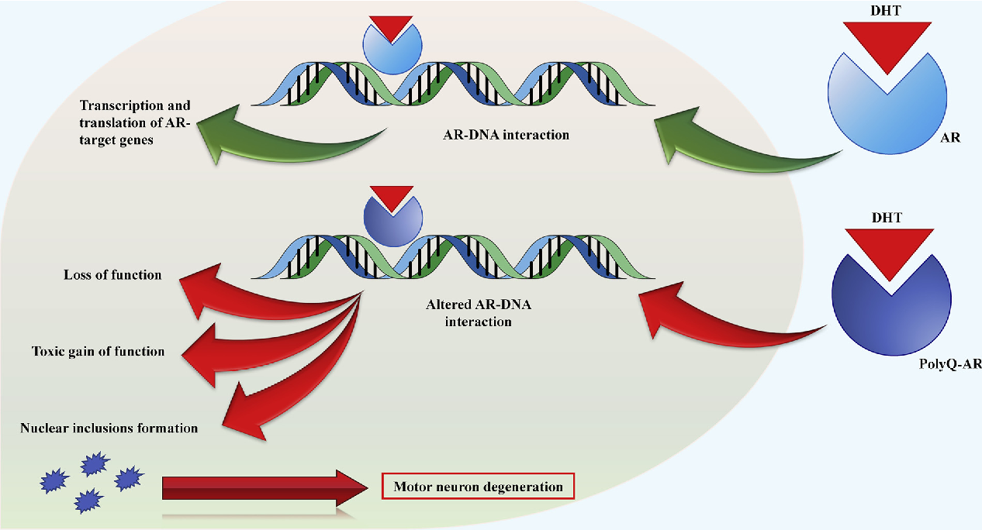
Kennedy’s disease
CAG repeat in the AR gene on the X chromosome
The diagnosis is confirmed by genetic testing
Notes:
androgen insensitivity

Slide 25
Kennedy’s disease
Involvement of the bulbar muscles
Difficulty with speech articulation and swallowing
Risk of choking on food and aspiration pneumonia
weakness and atrophy of the face and tongue muscles, with perioral fasciculations

Slide 26
Kennedy’s disease
47% of patients experience laryngospasms that occur spontaneously during routine daily activities, but are self-limited
May increase risk of laryngospasm with airway manipulation during anesthesia

Slide 27
Kennedy’s disease
Patients may have significant weakness of respiratory muscles → adequate breath or cough well enough to clear secretions
pre-op pulmonary function test

Slide 28
Differential diagnosis
Amyotrophic lateral sclerosis (ALS)
Myasthenia gravis

Slide 29
Chronic viral hepatitis B infection
Assessment of liver function
  Synthetic function
  Secretory & Excretion function
  Metabolic function
Cirrhosis , portal hypertension

Slide 30
R1
Preoperative preparation & Premedication

Slide 31
Preop preparation
Inform consent
NPO
Warm IV fluid
ATB
Force air warmer
TOF monitor

Slide 32
Premedication
Aspiration prophylaxis
Ranitidine 50 mg i.v.
Metoclopramide 10 mg i.v.

Slide 33
Choice of anesthesia
GA with ETT with RSI with cricoid pressure

Slide 34
Intraoperative management
Monitoring : EKG , NIBP , O₂sat , EtCO₂
Position : Reverse Trendelenburg
Special monitoring : Acceleromyography (TOF)
Notes:
ต่อไป consideration

Slide 35
R2
Anesthetic consideration

Slide 36
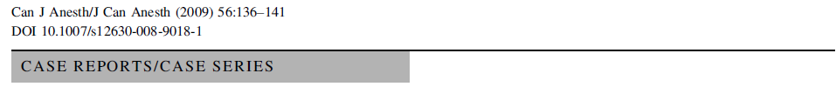
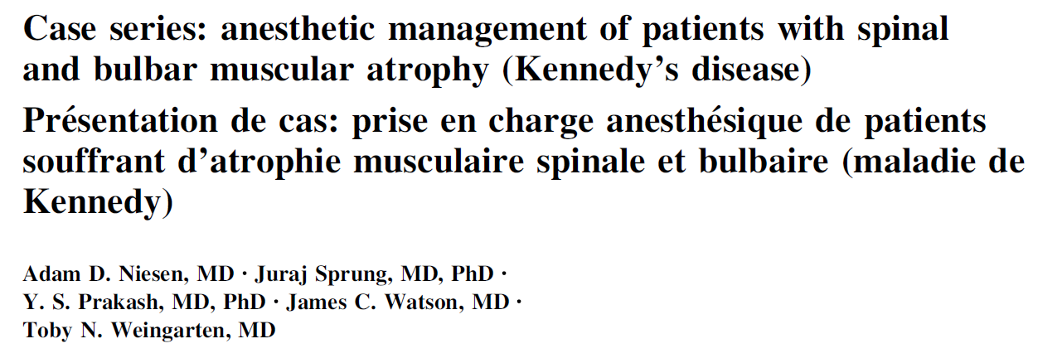

Slide 37
Prior to induction, most patients received midazolam 2 mg iv
All patients received fentanyl 1–2 mcg/kg iv
Induction with either propofol (1–2 mg/kg) or thiopental (3–5 mg/kg)
A. D. Niesen, J. Sprung, Y. S. Prakash, J. C. Watson, and T. N. Weingarten, “Case series: anesthetic management of patients with spinal and bulbar muscular atrophy (Kennedy's disease),” Canadian Journal of Anesthesia, vol. 56, no. 2, pp. 136–141, 2009

Slide 38
Each patient received a neuromuscular blocking agent at induction during at least one procedure, with two patients receiving succinylcholine
Vecuronium was used to maintain neuromuscular blockade in three cases
Anesthesia was maintained with volatile anesthetics, one patient also received a propofol infusion
A. D. Niesen, J. Sprung, Y. S. Prakash, J. C. Watson, and T. N. Weingarten, “Case series: anesthetic management of patients with spinal and bulbar muscular atrophy (Kennedy's disease),” Canadian Journal of Anesthesia, vol. 56, no. 2, pp. 136–141, 2009

Slide 39
Analgesia was achieved with either fentanyl or oxymorphone
A. D. Niesen, J. Sprung, Y. S. Prakash, J. C. Watson, and T. N. Weingarten, “Case series: anesthetic management of patients with spinal and bulbar muscular atrophy (Kennedy's disease),” Canadian Journal of Anesthesia, vol. 56, no. 2, pp. 136–141, 2009

Slide 40
Reversal of neuromuscular blockade was documented in four cases with the use of neostigmine as an anticholinesterase inhibitor and glycopyrrolate for antimuscarinic activity
A. D. Niesen, J. Sprung, Y. S. Prakash, J. C. Watson, and T. N. Weingarten, “Case series: anesthetic management of patients with spinal and bulbar muscular atrophy (Kennedy's disease),” Canadian Journal of Anesthesia, vol. 56, no. 2, pp. 136–141, 2009

Slide 41
Intraoperative warming was achieved using a forced air warming blanket and/or increase in ambient temperature (no significant hypo- or hyperthermia was recorded)
A. D. Niesen, J. Sprung, Y. S. Prakash, J. C. Watson, and T. N. Weingarten, “Case series: anesthetic management of patients with spinal and bulbar muscular atrophy (Kennedy's disease),” Canadian Journal of Anesthesia, vol. 56, no. 2, pp. 136–141, 2009

Slide 42
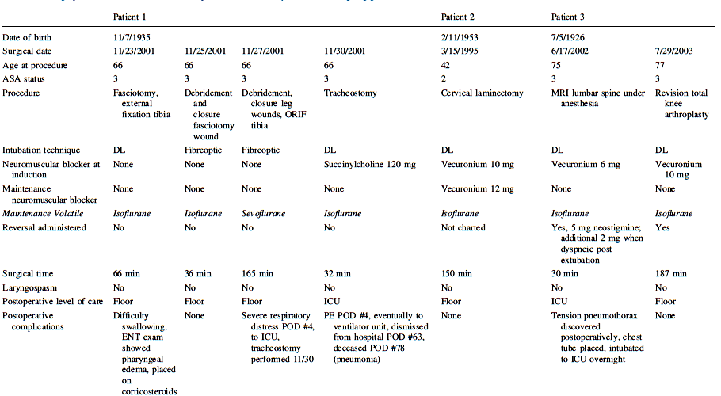

Slide 43
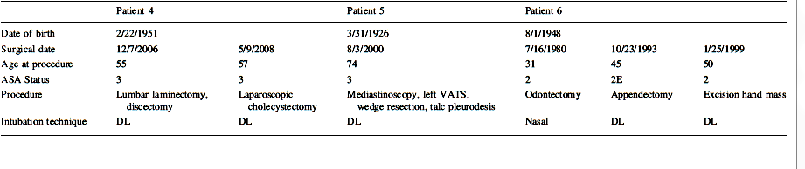
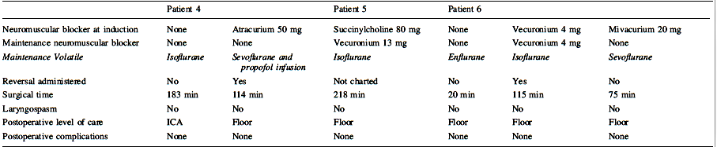
A. D. Niesen, J. Sprung, Y. S. Prakash, J. C. Watson, and T. N. Weingarten, “Case series: anesthetic management of patients with spinal and bulbar muscular atrophy (Kennedy's disease),” Canadian Journal of Anesthesia, vol. 56, no. 2, pp. 136–141, 2009

Slide 44
Muscle Relaxants
Tend to have a more profound and prolonged effect in NMD patients
Succinylcholine should usually be avoided in NMD (hyperK)
Linton C. Hopkins M.D. https://www.kennedysdisease.org/index.php/share-information/medical-info/76-surgery-concerns
Notes:
Decreased levels of acetylcholine may increase a patient’s sensitivity to non‐depolarizing neuromuscular blocking agents in motor neuron disease

Slide 45
Sugammadex
Several previous reports have demonstrated the safety of sugammadex in patients with neuromuscular disease
  Myasthenia gravis
  Myotonic dystrophy
  Transverse myelitis
  Duchenne muscular dystrophy
R. Takeuchi, H. Hoshijima, K. Doi, and H. Nagasaka, “The use of sugammadex in a patient with Kennedy's disease under general anesthesia,” Saudi Journal of Anaesthesia, vol. 8, no. 3, pp. 418–420, 2014

Slide 46
Sugammadex
Case report
62-year-old male patient with KD, weighing 70 kg and 173 cm tall, was scheduled for frontal sinusectomy
propofol 80 mg and remifentanil 0.25 mcg/kg/h
40 mg rocuronium boluses → intubation
Neuromuscular monitoring indicate T1, then administered 2.0 mg/kg (150 mg) sugammadex → 120s T4/T1 = 1.0
R. Takeuchi, H. Hoshijima, K. Doi, and H. Nagasaka, “The use of sugammadex in a patient with Kennedy's disease under general anesthesia,” Saudi Journal of Anaesthesia, vol. 8, no. 3, pp. 418–420, 2014
Notes:
general anesthesia was induced via propofol 80 mg and remifentanil 0.25 μg/kg/h
Anesthesia was maintained uneventfully with 5-8 mg/kg/h propofol and remifentanil 0.2-0.25 μg/kg/min in oxygen and air.
During the operation, 60 min after the administration of rocuronium, the Anesthesiologist could detect a T1 response

Slide 47
Local anesthetics
Case report
A 57‐yr‐old, 61 kg, 163 cm, man was undergoing an internal urethrotomy for urethral stenosis
Epidural anaesthesia → no complication
E. Okamoto K. Nitahara M. Yasumoto K. Higa ,”Use of epidural anaesthesia for surgery in a patient with Kennedy’s disease” , BJA: British Journal of Anaesthesia, Volume 92, Issue 3, March 2004, Pages 432–433

Slide 48
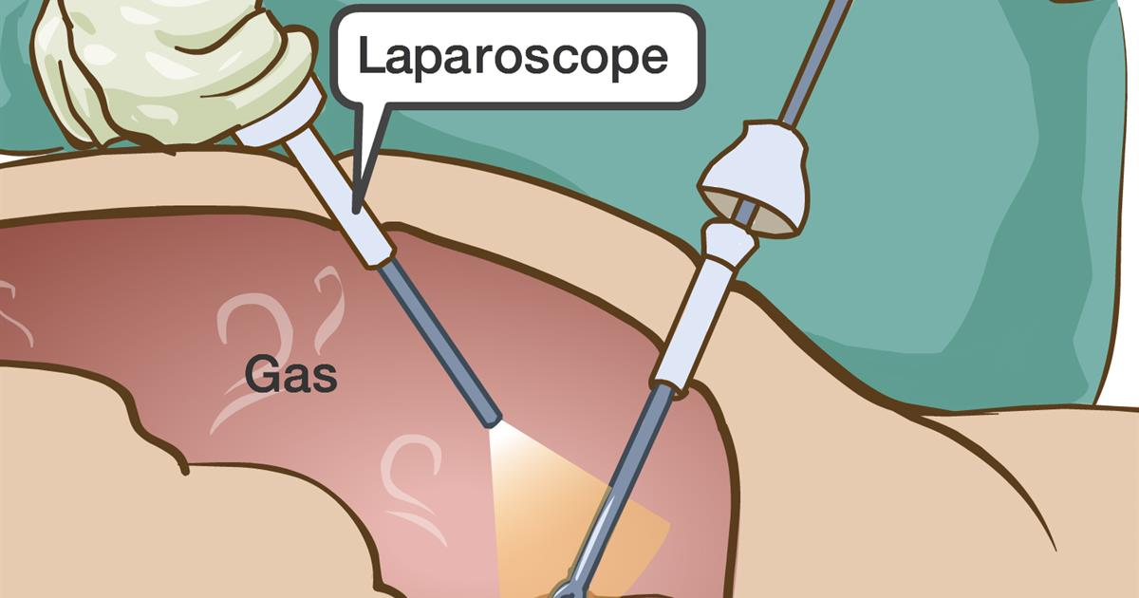
Laparoscopic surgery
Adventages of minimally invasive surgery

Slide 49
Physiologic effect
CVS

Slide 50
Physiologic effect
RS
Require MV increase 20-30%

Slide 51
Physiologic effect
Regional circulation change

Slide 52
Physiologic effect
Renal function effect

Slide 53
PONV
Laparoscopic surgery is high risk for PONV
(intraperitoneal insufflation and bowel manipulation)

Slide 54
Complication
Subcutaneous Emphysema
Pneumothorax
Capnothorax
Gas Embolism
Endobronchial intubation
Perforations , lacerations, Hemorrhage

Slide 55
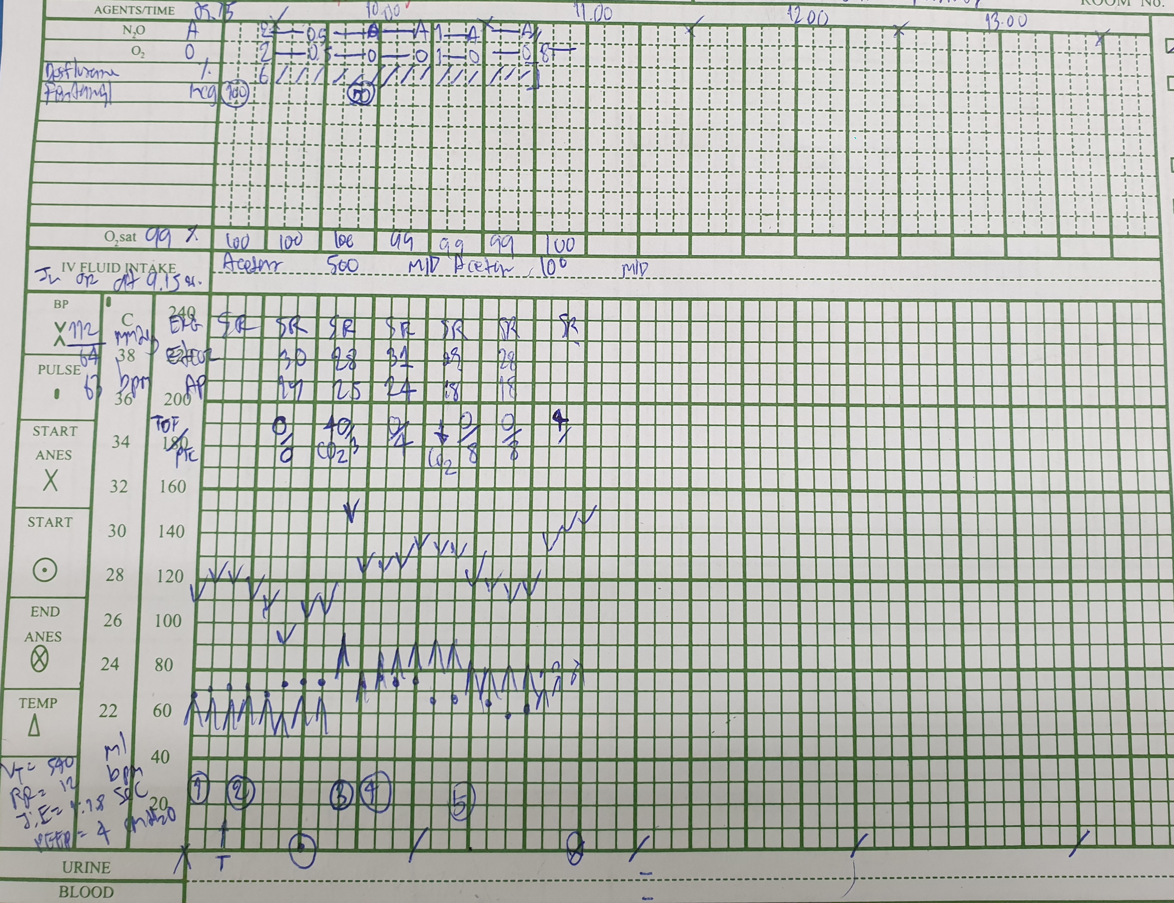
Start Anes 9.15น.
BP 112/64 mmHg
PR 63 bpm

Slide 56
Induction & intubation:
Propofol 200 mg
Rocuronium 70 mg
ETT no 8.0 depth 22 cm
Fentanyl 100 mcg

Slide 57
Rt. Subcostal TAP block
0.25%Bupivacaine 40 ml

Slide 58
Start surgery : 9.45 น.
Maintainance: Air:O₂:0.5:0.5 Desflurane6%
Muscle relaxant: -
Analgesia : Fentanyl 150 mcg
Reverse : TOF=2 Sugammadex 150 mg → TOF = 4(100%) Extubate
Antiemitic : Onsia 8 mg IV, Plasil 10 mg
IV fluid : Acetar 600 ml
EBL : 50ml
Operation time : 1 Hr 45 min

Slide 59
Post-operative day1
S :ตื่นดี ปวดแผลPS2/10 ไม่มีไข้ หายใจปกติ ไม่มีอ่อนแรง
O : BP 120/78 mmHg PR 70BPM BT 37.0°C RR 16 breaths /min
Motor grade V all
A + P :
Discharge
HM Paracetamol (500) 1 tab po prn q 4hr
Tramol 1 cap po prn q 8 hr

Slide 60


